Slide 1
Credit Card Credibility Analysis
CAPSTONE PROJECT
Presented By:
1. Gokulnath P –university college of engineering kanchipuram (ucek)-mechanical engineering

Slide 2
OUTLINE
Problem Stateme
Proposed System/Solution
System Development Approach
Algorithm & Deployment
Result
Conclusion
Future Scope
References

Slide 3
Problem Statement
The project aims to predict customer credit card payment default, so that the bank or industries can find out credible customers and non-credible customers.
The perspective of risk management, the result of predictive accuracy of the estimated probability of default will be more valuable than the binary result of classification - credible or not credible clients

Slide 4
Proposed Solution
The data analysis of the given data set would reveal significant information about the credibility of a certain type of customer.
By identifying the type of customer the concerned corporate or bank can increase or decrease the credit limit of a certain type of customer.
By finding out the pattern in credit defaulters it would provide a predictive pattern for finding future credit defaulters.

Slide 5
System Approach
Building the proposed solution requires combination of data processing ,feature engineering ,data visualization
System requirements:
Hardware requirements:
Processor (CPU):
A multi-core processor is recommended, especially for handling large datasets and complex computations.
Memory (RAM):
Sufficient RAM to accommodate the dataset and perform computations. At least 8GB of RAM is recommended for most data analysis tasks, but more may be required for larger datasets

Slide 6
System approach
Software requirement :
An os compatable with the project to run it smooth (windows ,mac ,linux)
Library requirement:
Data processing and analysis:
Pandas
Data visualization:
Matplotlib , seaborn ,scipy

Slide 7
Algorithm & Deployment
Data Loading and Exploration: Load the dataset and explore its structure and contents.
Data Preprocessing: Handle missing values, encode categorical variables, and perform any necessary data transformations.
Data Visualization:
Scatter plots to visualize relationships between different features.
Pair plots for a comprehensive view of pairwise relationships.
KDE plots to visualize the distribution of numeric features.
Kolmogorov-Smirnov Test: Perform the KS test to compare the distributions of defaulters and non-defaulters for selected features.
Conclusion: Summarize the findings and insights obtained from the analysis.

Slide 8
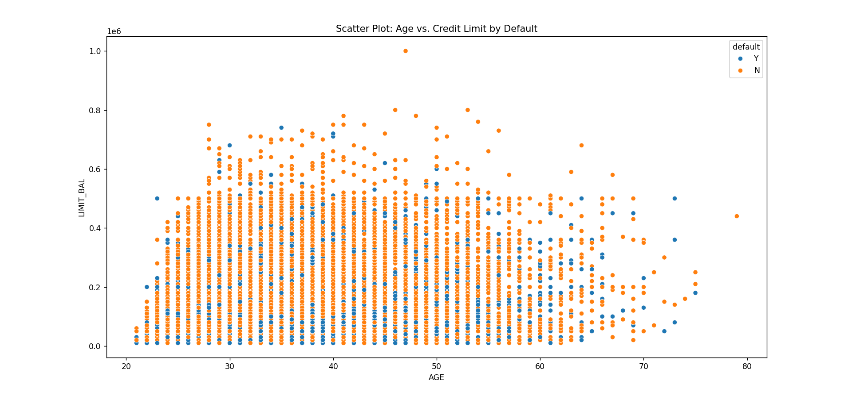
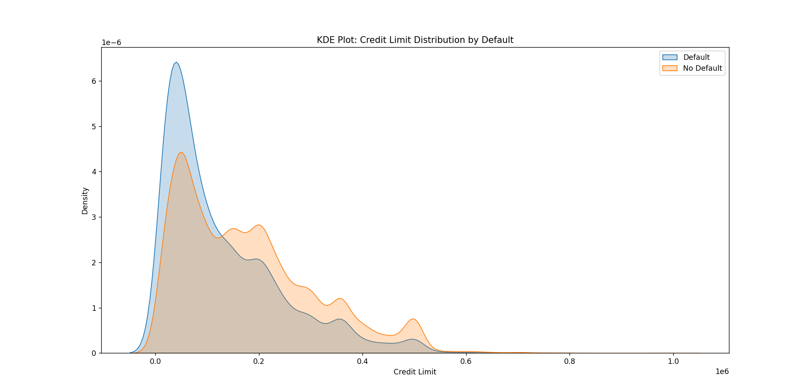
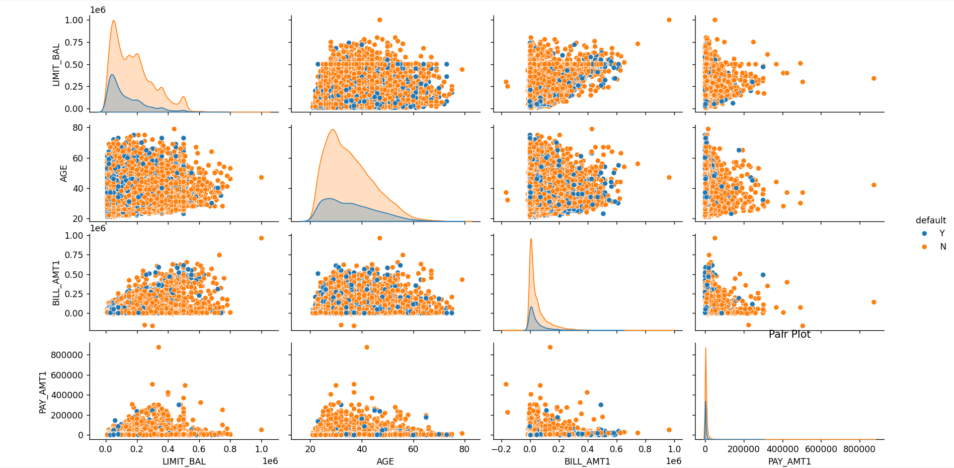
Result

Slide 9
Conclusion
The analysis highlights the importance of payment history, credit limit, age, and education level in determining credit default risk. By understanding these factors, financial institutions can better assess and manage credit risk, ultimately reducing the incidence of default and improving overall portfolio performance.
Payment History Influence: Our analysis revealed a strong correlation between payment history (as represented by PAY_1, PAY_2, etc.) and the likelihood of credit default. Customers who consistently made late payments or failed to pay their bills on time were significantly more likely to default on their credit.
Impact of Credit Limit: We observed that customers with higher credit limits tended to have lower default rates. This suggests that credit limit plays a crucial role in managing credit risk, with higher limits providing more financial flexibility and reducing the likelihood of default.
Age and Education: Interestingly, we found that age and education level were also significant predictors of credit default. Younger individuals and those with lower levels of education were more likely to default on their credit obligations compared to older, more educated individuals.
Model Performance: Our machine learning models, including random forest and logistic regression, achieved strong performance in predicting credit default. The models exhibited high accuracy and precision, indicating their effectiveness in identifying customers at risk of default.

Slide 10
Future scope
analysis has provided valuable insights into credit default prediction, there are several avenues for future exploration and improvement:
Feature Engineering: Further exploration of feature engineering techniques could enhance the predictive power of our models. Additional features, such as customer demographics, employment status, or transaction history, may provide valuable information for credit risk assessment.
Model Tuning: Fine-tuning the hyperparameters of our machine learning models could optimize their performance and robustness. Techniques such as grid search or Bayesian optimization could be employed to find the optimal set of hyperparameters for each model.
Ensemble Methods: Exploring ensemble methods, such as stacking or boosting, could potentially improve the predictive accuracy of our models by combining the strengths of multiple algorithms. Ensemble methods have been shown to outperform individual models in many machine learning tasks.

Slide 11
References
Calculate KS Statistic (with Python Code) (listendata.com)
https://youtu.be/GsfT2sv_zCo?si=xb2ko8WhXD7mCsz9

Slide 12
THANK YOU

